Slide 1

PROJECT COMMUNICATION MANAGEMEMT
BAI3020

Slide 2
PROJECT COMMUNICATION MANAGEMEMT
Project Communication Management?
Notes:
Who can tell me what project communication management means?
Creates a bridge between the diverse stakeholders involved in the project, that connects cultural and organizational backgrounds, connects different expertise, and brings various perspectives and interests throughout the execution and outcome of the project.
It ensures that timely and appropriate generation, collection, distribution, storage and ultimate disposition of the project information.
It is important to note, that PM’s spend the majority of their time communicating with project team members, stakeholders and sponsor(s). Remember this is not limited you internal organization, it is also inclusive of external stakeholders to your organization.
All the communication processes interact with each other and with the processes in the other 8 knowledge areas of PM. Each process occurs at least once in the project.

Slide 3
Importance of Good Communications
The greatest threat to many projects is a failure to communicate
Our culture does not portray IT professionals as being good communicators
Research shows that IT professionals must be able to communicate effectively to succeed in their positions
Strong verbal skills are a key factor in career advancement for IT professionals

Slide 4
Project Communications Management Processes
Identifying stakeholders: identifying everyone involved in or affected by the project and determining the best ways to manage relationships with them
Planning communications: determining the information and communications needs of the stakeholders
Distributing information: making needed information available to project stakeholders in a timely manner
Managing stakeholder expectations: managing communications to satisfy the needs and expectations of project stakeholders and to resolve issues
Reporting performance: collecting and disseminating performance information, including status reports, progress measurement, and forecasting

Slide 5
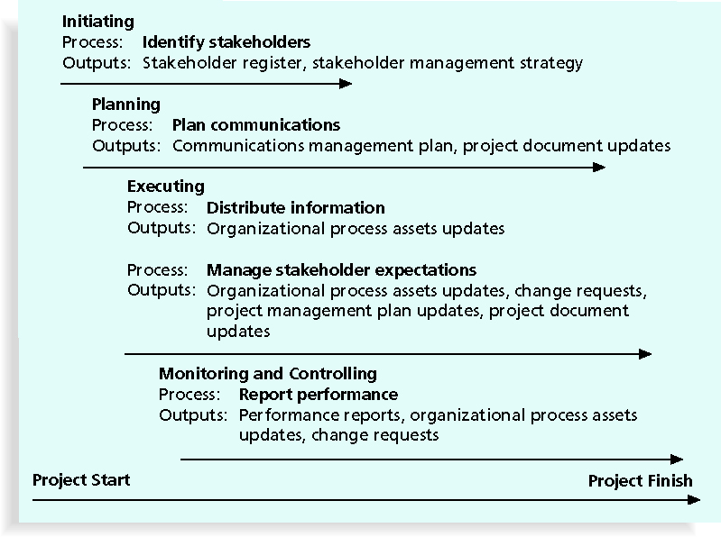
Project Communications Management

Slide 6

PROJECT COMMUNICATION MANAGEMEMT
Planning:
Who should receive
Information on the project
through out its life cycle?
Notes:
Before we begin, break out into our WOW project teams.
Rules:
All team members must participate
Expect to see team members take turns recording the group’s answers on the flipcharts, and in reporting back to the larger group.
Answer the following question: Whom do we communicate to on a project/ who should receive project information on the project?
List the stakeholders names.
Looking for up to nine.

Slide 7
PROJECT COMMUNICATION MANAGEMEMT
Sponsor
Functional Managers
Team Members
Other Project Managers
Project
Other Projects
Other Stakeholders

Slide 8
PROJECT COMMUNICATION MANAGEMEMT
Internal stakeholders to the project
External stakeholders to the project
Sponsor
Management
Project Manager
Team
Team members’ functional managers
Other project managers
Other stakeholders
Notes:
Here are some types of individuals that should receive the project information.

Slide 9
Identifying Stakeholders
Recall that the ultimate goal of project management is to meet or exceed stakeholder needs and expectations from a project, so you must first identify who your particular project stakeholders are
Two key outputs of this process include:
Stakeholder register: a public document that includes details related to the identified project stakeholders
Stakeholder management strategy: an approach to help increase the support of stakeholders throughout the project; often includes sensitive information

Slide 10
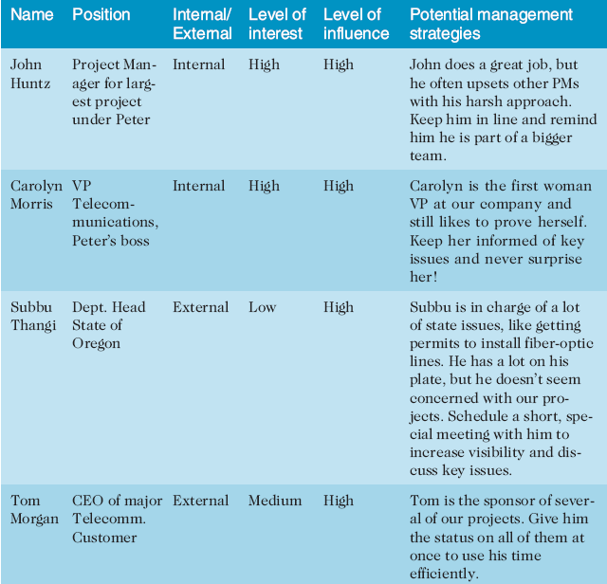
Stakeholder Management Strategy

Slide 11
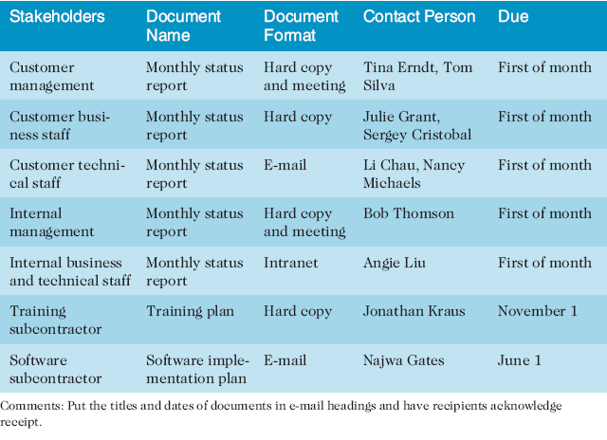
Stakeholder Analysis for Project Communications

Slide 12
PROJECT COMMUNICATION MANAGEMEMT
COMMUNICATION MODEL
Message
Sender
Receiver
Notes:
Each message is encoded by the sender and decoded by the receiver based on the receiver’s education, experience, language and culture.

Slide 13
Importance of Face-to-Face Communication
Research says that in a face-to-face interaction:
58 percent of communication is through body language
35 percent of communication is through how the words are said
7 percent of communication is through the content or words that are spoken
Pay attention to more than just the actual words someone is saying
A person’s tone of voice and body language say a lot about how he or she really feels

Slide 14
PROJECT COMMUNICATION MANAGEMEMT
EFFECTIVE COMMUNICATION:
Nonverbal
Paralingual
is the pitch and tone of a voice that helps to
convey a message
Feedback
Notes:
The sender needs to encode a message carefully, determine the type of communication method and confirm the message was understood.
Nonverbal – 58% of communication is nonverbal
Paralingual – is the pitch and tone of a voice that helps to convey a message – 35% “how words are said”
Content – 7% content of words
Feedback – Saying things like “do you understand what I explained?”

Slide 15
PROJECT COMMUNICATION MANAGEMEMT
EFFECTIVE LISTENING
Feedback
Active Listening
Paralingual
Notes:
The receiver needs to decode the message carefully and confirm the message is understood. This includes watching the speaker to pick up on physical gestures, facial expressions and so forth. The receiver needs to confirm and repeat the information received from the sender is understood.
Listen to the Sender – do not fall into the trap where you are beginning to formulate your response in your mind, mean while the sender is still communicating.
Feedback
Active Listening – the receiver confirms he/she is listening, confirms agreement or asks for clarification.
Paralingual

Slide 16
PROJECT COMMUNICATION MANAGEMEMT
COMMUNICATION METHODS
Formal written
Formal verbal
Informal written
Informal verbal
Notes:
In order to have clear, concise communications, the PM must handle communications in a structured manner by selecting the form of communication that is best for the situation.
For example:
Formal written – complex problems, project management plans, project charter, communicating over long distances
Formal verbal- presentations, speeches
Informal written – Memos, emails, notes
Informal verbal – meetings and conversations

Slide 17
PROJECT COMMUNICATION MANAGEMEMT
WHAT CAN GET IN THE WAY OF COMMUNICATION?
Notes:
Ask the question to the class and look for the response “communication blockers”
Then ask the class to provide examples of communication blockers.

Slide 18
PROJECT COMMUNICATION MANAGEMEMT
COMMUNICATION BLOCKERS:
Noise
Distance
Improper encoding of messages
Saying “that is a bad idea, or it won’t work
Hostility
Language
Culture

Slide 19
PROJECT COMMUNICATION MANAGEMEMT
CONTROL OF COMMUNICATION
PROJECT MANAGER - 90%
Notes:
A PM should try to control communications, otherwise changes and miscommunications, unclear directions and scope creep can occur.

Slide 20
PROJECT COMMUNICATION MANAGEMEMT
MEETINGS
Notes:
PM may have different types of meetings, realizing that meetings are a problem, inefficiency of the meetings.
What are some basic rules when conducting a meeting:
Set a time limit and keep to it
Schedule reoccurring meetings in advance
Meet with project team regularly
Have a purpose for each meeting
Create an agenda
Distribute the agenda
Stick to the agenda
Let participants know their responsibilities in advance
Bring the right people to the meeting
Chair and lead the meeting with a set of rules
Assign deliverables and time limits for all work that results from the meetings
Document and publish meeting minutes

Slide 21
Holding efficient Meeting’s
Set a time limit and keep to it
Schedule reoccurring meetings in advance
Meet with project team regularly
Have a purpose for each meeting
Create an agenda
Distribute the agenda
Stick to the agenda
Let participants know their responsibilities in advance
Bring the right people to the meeting
Chair and lead the meeting with a set of rules
Assign deliverables and time limits for all work that results from the meetings
Document and publish meeting minutes

Slide 22
Encouraging More Face-to-Face Interactions
Short, frequent meetings are often very effective in IT projects
Stand-up meetings force people to focus on what they really need to communicate

Slide 23
Using E-Mail, Instant Messaging, and Collaborative Tools Effectively
Do not get personal!
Make sure that e-mail, instant messaging, or collaborative tools are an appropriate medium for what you want to communicate
Be sure to send information to the right people
Use meaningful subject lines, limit the content of e-mails to one main subject, and be as clear and concise as possible
Be sure to authorize the right people to share and edit your collaborative documents

Slide 24
Collaborative Tools cont.
Moodle, Web WebCT, FTP, Dropbox etc. are useful communication tools
A SharePoint portal allows users to create custom Web sites to access documents and applications stored on shared devices
Google Docs or Google Drive allow users to create, share, and edit documents, spreadsheets, and presentations online
A wiki is a Web site designed to enable anyone who accesses it to contribute or modify Web page content
Other useful tools involve social networking as Linked-In, Facebook, Twitter etc.

Slide 25
Determining the Number of Communications Channels
As the number of people involved increases, the complexity of communications increases because there are more communications channels or pathways through which people can communicate
No. of comm. Channels = :[N(N-1)]/2
Number of communications channels where n is the number of people involved

Slide 26
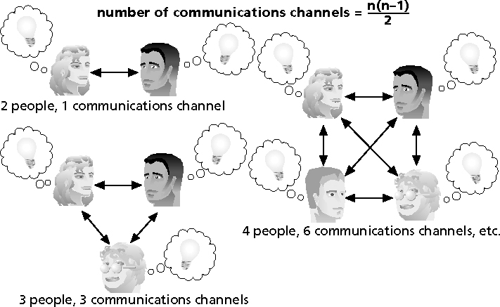
The Impact of the Number of People on Communications Channels

Slide 27
PROJECT COMMUNICATION MANAGEMEMT
COMMUNICATION MANAGEMENT PLAN
What needs to be communicated | Why | Between whom | Best method for communicating | Responsibility | When and how often
Notes:
The project communication management plan is a direct out of communication planning.
A communication management plan documents how a PM will manage and control communications.
Here is communication management template, and also on some projects a more detailed communication structure is required.

Slide 28
PROJECT COMMUNICATION MANAGEMEMT
INFORMATION DISTRIBUTION
Notes:
Information distribution involves executing the project communication plan.
In addition, since we all know that not everything can be planned, information distribution also involves creating reports or providing information that was not planned.

Slide 29
Distributing Information
Getting the right information to the right people at the right time and in a useful format
Important considerations include:
Using technology to enhance information distribution
Formal and informal methods for distributing information

Slide 30
Distributing Information in an Effective and Timely Manner
Don’t bury crucial information
Don’t be afraid to report bad information
Oral communication via meetings and informal talks helps bring important information—good and bad—out into the open

Slide 31
PROJECT COMMUNICATION MANAGEMEMT
PERFORMANCE REPORTING
Status Report
Progress Report
Trend Report
Forecasting Report
Variance Report
Earned Value
Lessons Learned
Notes:
Status Report – describes where the project now stands aligned to the performance measurement baselines, cost, schedule and scope, quality.
Progress Report – describes what has been completed on the project
Trend Report – explains project results over time to see if the project is improving or deteriorating
Forecasting Report – predicting future project status and performance
Variance Report – Comparing actual results to baselines
Earned Value – integrating scope, cost and schedule measures to assess project
Lessons Learned
The key here is to realize that performance is reported against performance measurement baselines set in the project management plan.

Slide 32
PROJECT COMMUNICATION MANAGEMEMT
Lesson Learned Report should include?
Notes:
To be of valuable Lessons Learned should cover three areas:
Technical aspects of the project
Project management (how did we do with the WBS creation, risk, etc.)
Management (how did I do with communications and leadership as a project manager

Slide 33
PROJECT COMMUNICATION MANAGEMEMT
PERFORMANCE REPORTING RESULTS:
Issuing of reports
Feedback on reports
Lessons learned
Requested changes
Project Documentation
Notes:
Issuing of reports from the other 8 Knowledge areas
Feedback from stakeholders on the reports
Lessons learned
Requested changes to project management plan and project communication plan
Project Documentation: Reports, forecasts, requested changes or correction actions and lessons learned documentation.

Slide 34
Project Archives
It is also important to organize and prepare project archives
Project archives are a complete set of organized project records that provide an accurate history of the project
These archives can provide valuable information for future projects as well

Slide 35
Communication project handoff
When handing project documents to operations, particularly in SMB or large Multi-national business one has to integrate the project into the operations of the organization. – Sycrude has a long and tedious integration documentation process called the Operational Acceptance Criteria (OAC)which requires many signatures

Slide 36
Project Web Sites
Many project teams create a project Web site to store important product documents and other information
Can create the site using various types of software, such as enterprise project management software
Operational Acceptance Criteria (OAC)

Slide 37
PROJECT COMMUNICATION MANAGEMEMT
MANAGE STAKEHOLDERS
Stakeholders’ needs and expectations must continue to be met and their issues resolved through the project.
Notes:
Manage Stakeholders is a communications function.
When managing stakeholders a PM needs to choose the best communication method.
For example an Issue log as discussed in the Project HR is also a means/tool for communicating issues to the stakeholders.

Slide 38
PROJECT COMMUNICATION MANAGEMEMT
APPROVED CHANGE REQUESTS and APPROVED CORRECTIVE ACTIONS
Notes:
Lastly, the approved change requests and approved corrective actions a direct outputs of the manage stakeholders process in project communication management.
Remember the changes and corrective actions are approved through the integrated change control process.

Slide 39
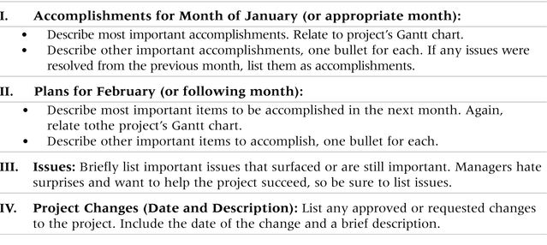
Sample Template for a Monthly Progress Report

Slide 40
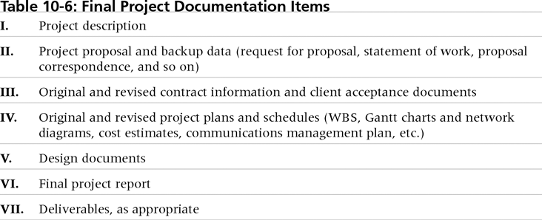
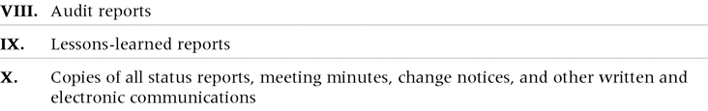
Final Project Documentation Items

Slide 41
Status/Progress Report
Project Name: Team Member Name: Date: Reporting Period:
Work completed this reporting period:
Work to complete next reporting period:
What’s going well and why:
What’s not going well and why:
Suggestions/Issues:
Project changes

Slide 42
PROJECT COMMUNICATION MANAGEMEMT

